Slide 1
LUMBAR CANAL STENOSIS
Dr. Goutami Katage Shah
Dept. Of Musculoskeletal Physiotherapy
MGM Institute Of Physiotherapy
Chh. Sambhajinagar

Slide 2
CONTENTS
Definition
Cause
Clinical features
Investigations
Management

Slide 3
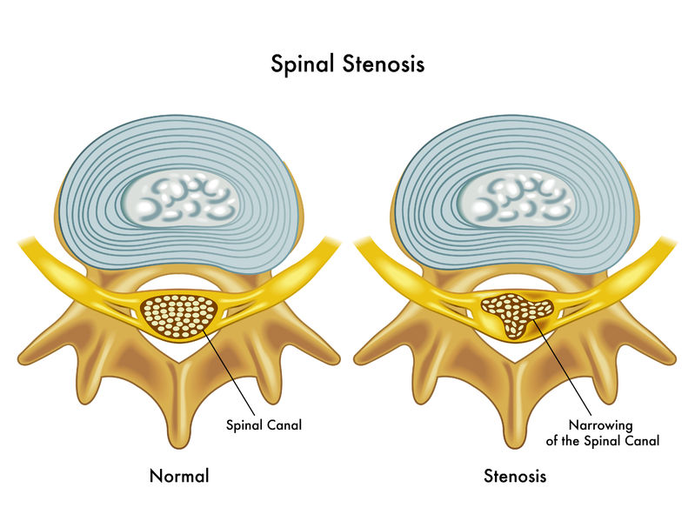
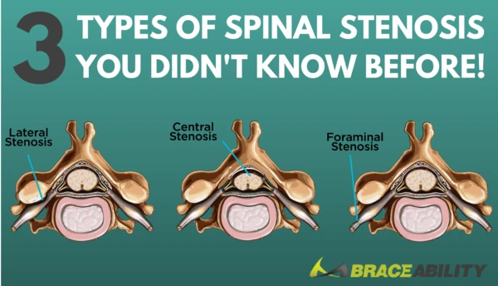

Slide 4
is a degenerative condition in which there is diminished space available for the neural and vascular elements in the lumbar spine secondary to degenerative changes in the spinal canal.
can cause radiating pain and numbness to the buttock, thigh, or leg particularly during walking or standing for a long time. The pain reduces usually when a patient is in resting, sits down, or bends forward.
Spinal stenosis is one of the most common causes of nontraumatic spinal cord injuries in people older than 50 years.Because of the aging of the population, incidence rates of acquired (or degenerative) spinal stenosis have been increasing. This kind of stenosis is due to the degenerative changes (ligamentum flavum, disc intervertebral, and facet joints) related to aging and occurs at the age of 50 and beyond

Slide 5
There are several types of spinal stenosis. Lumbar spinal stenosis and cervical spinal stenosis are the most common types and occur separately or combined. The thoracic spine is rarely involved. The incidence of both types increases during the aging process
Some people are born with a small spinal canal. This is called "congenital stenosis”. However, spinal canal narrowing is most often due to age-related changes that take place over time. This condition is called "acquired spinal stenosis." Spinal stenosis is most common in people over 50 years of age.

Slide 6
CAUSES
Degenerative spondylosis. With aging, wear-and-tear changes, and traumas, amongst other factors, the intervertebral discs can degenerate and protrude posteriorly, causing increased loading of the posterior elements of the vertebrae. This can lead to posterior vertebral osteophyte formation (uncinate spurs), facet hypertrophy, synovial facet cysts, and ligamentum flavum hypertrophy, which in turn will cause spinal stenosis.
Degenerative spondylolisthesis. When degenerative changes of the spine occur, the pars interarticularis can be fractured, and the resulting instability can lead to forward translation of the vertebra. Sufficient anterior slippage of one vertebra on top of the next vertebral segment (most commonly L4-on-L5) can narrow the spinal canal, leading to stenosis.

Slide 7
Osteoarthritis
Inflammatory spondyloarthritis
Bulging of the disc
Thickening of the vertebral ligament
Tumour
CLINICAL FEATURES
Classically, lumbar spinal stenosis presents as pain exacerbated
by prolonged ambulation,
standing, and with lumbar extension,
and is relieved by forward flexion and rest. Neurogenic claudication is an important feature of lumbar spinal stenosis.
Symptoms are typically bilateral, but usually asymmetric.
Low back pain, numbness, and tingling are present in a majority of patients.

Slide 8
Numbness and tingling in lumbar spinal stenosis involve usually the entire leg and rarely involves only a single nerve root distribution.
Approximately 43 percent of the patients experience weakness.
walking upstairs being easier than walking downstairs, as the back is forward flexed with stairs climbing.
If patients present with
bowel or bladder dysfunction,
saddle anesthesia,
bilateral lower extremity weakness and/ or increased lower extremity, the patient may have developed cauda equina or conus medullaris syndromes
Narrowing can occur at different sites. Anatomic/radiographic classification can be applied differentiating between:
- Central stenosis: narrowing of the spinal canal
- Lateral recess stenosis: narrowing of the lateral recess (area underneath the facet joints)
- Foraminal stenosis: narrowing of the intervertebral foramen

Slide 9
Classification
There are two main classification categories:
etiologic classification:
congenital - e.g. congenital lumbar spinal stenosis (some associated with achondroplasia)
acquired
arthritic changes
iatrogenic
traumatic
inflammatory

Slide 10
anatomic classification
  central - cross-sectional area <100 mm² or <10 mm AP diameter on axial CT ^{4,5}
  lateral - most commonly due to osteophyte formation -
    lateral recess stenosis
  foraminal - between the medial and lateral border of the pedicle
  extraforaminal - lateral to the lateral edge of the pedicle

Slide 11
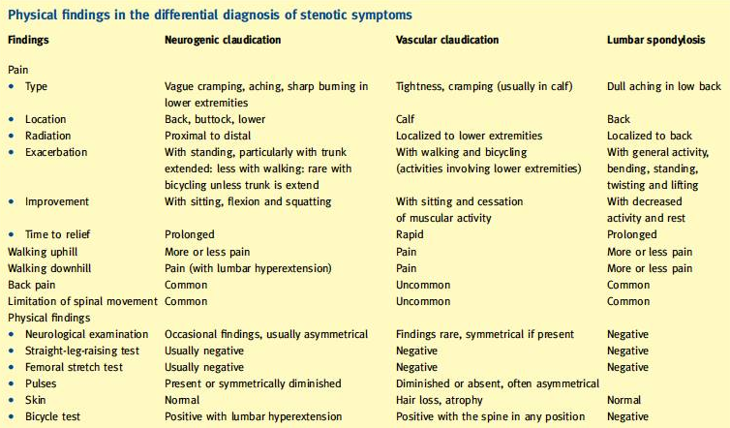

Slide 12
The symptom most commonly attributed to LSS is neurogenic claudication. Symptoms of spinal stenosis often start slowly and get worse over time. Pain in the legs may become so severe that walking, even short distances, is unbearable. Frequently, patients must sit or lean forward to temporarily ease pain
Neurogenic claudication refers to leg symptoms encompassing the buttock, groin and anterior thigh, as well as radiation down the posterior part of the leg to the feet.
In addition to pain, leg symptoms can include fatigue, heaviness, weakness and/or paraesthesia.
Patients with LSS also can report nocturnal leg cramps and neurogenic bladder symptoms.
Symptoms can be unilateral or more commonly bilateral and symmetrical.
A key feature of neurogenic claudication is its relationship to the patient’s posture where lumbar extension increases and flexion decreases pain. Symptoms progressively worsen when standing or walking and are relieved by sitting.

Slide 13
In the neck (cervical spine)
Numbness or tingling in a hand, arm, foot or leg
Weakness in a hand, arm, foot or leg
Problems with walking and balance
Neck pain
In severe cases, bowel or bladder dysfunction (urinary urgency and incontinence)
In the lower back (lumbar spine)
Numbness or tingling in a foot or leg
Weakness in a foot or leg
Pain or cramping in one or both legs when you stand for long periods of time or when you walk, which usually eases when you bend forward or sit
Back pain

Slide 14
INVESTIGATIONS
X RAY - bone spurs that may be narrowing the space within the spinal canal seen
Plain radiograph
standing AP and lateral may show nonspecific degenerative findings (disc space narrowing, osteophyte formation)
  less frequent are degenerative scoliosis and degenerative spondylolisthesis
flexion/extension radiographs may show segmental instability and subtle degenerative spondylolisthesis

Slide 15
MRI
Findings may include:
central stenosis, with the thecal sac measuring <100 mm² in area ⁵
obliteration of perineural fat and compression of lateral recess or foramen
facet and ligament hypertrophy
spinal stenosis may be incidentally discovered in asymptomatic patients

Slide 16
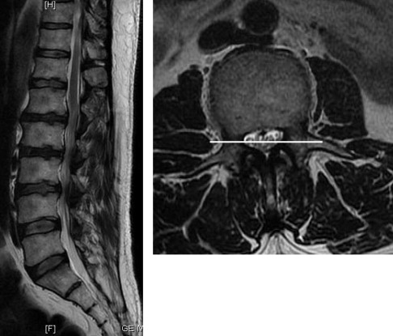
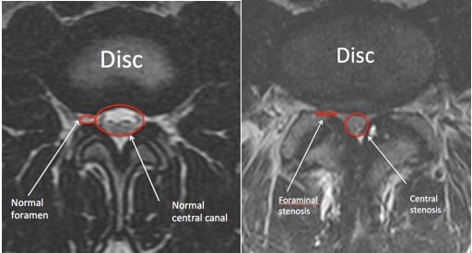

Slide 17
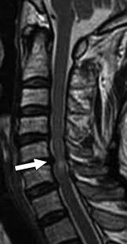
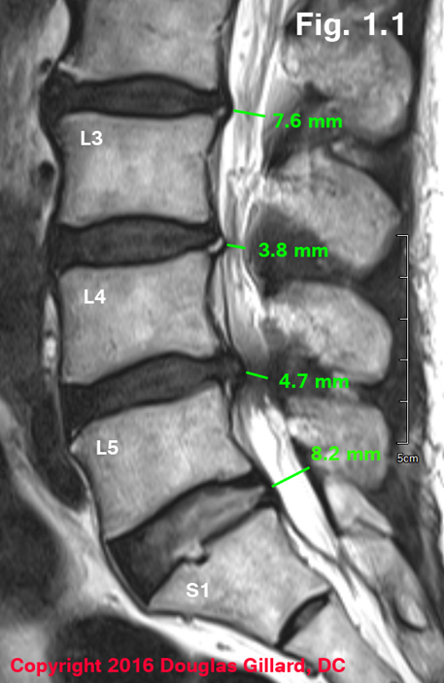

Slide 18
GOALS ……….
SHORT TERM
Patient education
To reduce pain
To reduce tingling / nerve symptoms
To reduces spasm
To increase strength
To improve gait , balance, proprioception

Slide 19
Long term goals
To maintain strength
To maintain nerve mobility
To maintain range
To maintain proprioception, balance
To maintain cardioendurance

Slide 20
PHYSIOTHERAPY TREATMENT
Flexion-based exercise programs -Lumbar flexion exercises are done to reduce the lumbar lordosis. This is the most comfortable position for the patient because the symptoms reduce in combination with a decrease of the epidural pressure in the lumbar spinal canal. -Single and double leg knees to chest in supine position. This position should be held maintained for 30 seconds. In the single leg exercise the patient should alternate the legs. Double knee is a progressive exercise. -This exercise program should have a stepwise logistic regression during the first 6 weeks. -Treadmill walking is the final step in this program.
Manual therapy

Slide 21
Lumbar isometric and stretching exercises
Static and dynamic postural exercises
Individualized muscle strengthening
Endurance exercises
Stabilization of abdominal and back muscles to avoid excessive lumbar extension
Postural and ergonomic advice
Falls prevention intervention in seniors with LSS. Seniors with chronic low back pain have a significantly higher risk of falls
Aerobic fitness
Cycling exercises
Home exercises

Slide 22
An aquatic walking and jogging program has a beneficial effect on muscle function tests, the BERG balance scale and the fall efficacy scale. The ankle range of motion also increased. This program still has to be investigated[64].
Corsets may help to maintain a posture of slight lumbar flexion to avoid atrophy of paraspinal muscles but it should be worn only for a limited number of hours per day. It also promotes back extension. A lumbar corset is significantly better than no corset for pain and walking capacities

Slide 23
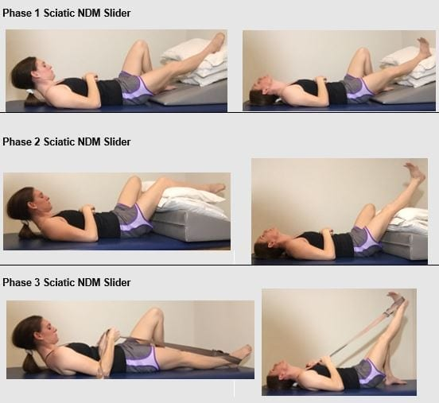

Slide 24
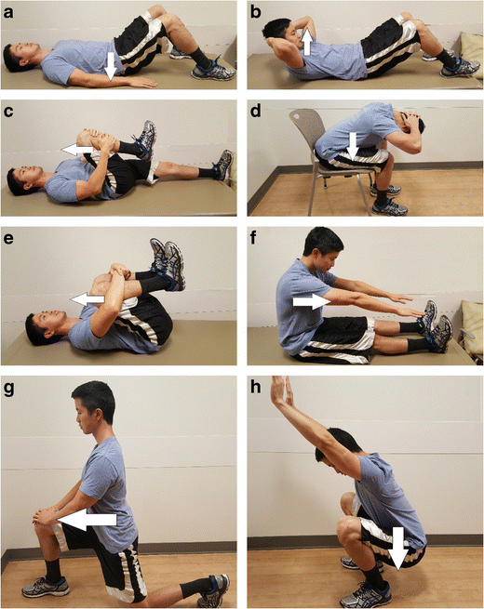

Slide 25
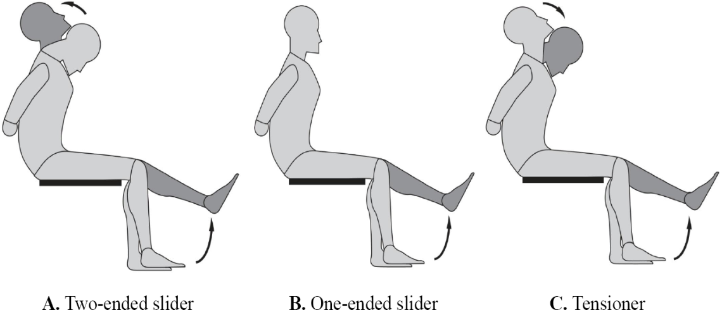

Slide 26
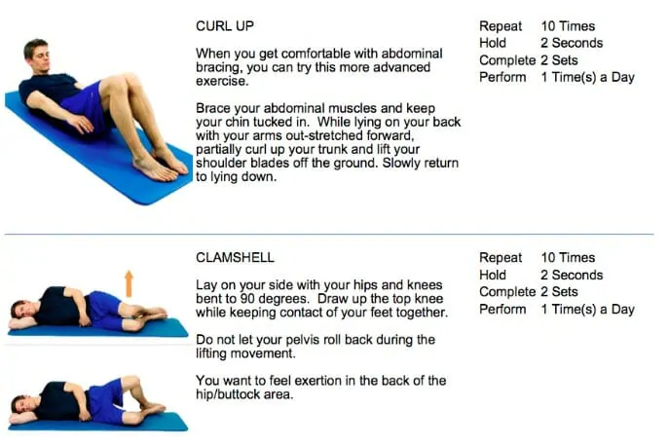
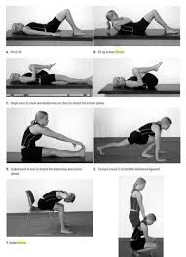

Slide 27
CERVICAL CANAL STENOSIS

Slide 28
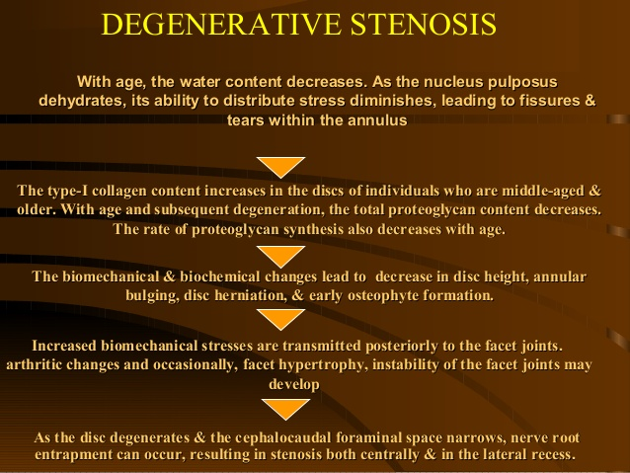

Slide 29
The pathophysiology of spinal stenosis is related to cord dysfunction elicited by a combination of mechanical compression and degenerative instability
With aging, the intervertebral disk degenerates and collapses, leading to spur formation.
This most commonly occurs at C5-6 and C6-7.
A relative decrease in spinal motion occurs at these levels with a concomitant increase in spinal motion at C3-4 and C4-5.
The spine responds to physiological stresses with bone growth at the superior and inferior margins of the vertebral body (osteophytes).
Osteophytes can form anteriorly or posteriorly. Posterior osteophytes narrow the intraspinal diameter and also cause lateral recess stenosis. This results in spinal cord or nerve root impingement.
Furthermore, arthritic degeneration causes formation of synovial cysts and hypertrophy of the facet joints, which further compromise the patency of the spinal canal and the neural foramina.

Slide 30
CLINICAL FEATURES
Numbness or tingling in a hand, arm, foot or leg
Weakness in a hand, arm, foot or leg
Problems with walking and balance
Neck pain
In severe cases, bowel or bladder dysfunction (urinary urgency and incontinence)

Slide 31
PT management
Stretching exercises: These exercises are aimed at restoring the flexibility of the muscles of the neck, trunk, arms and legs.
Manual therapy: Cervical and thoracic joint manipulation to improve or maintain the range of motion.
Heat therapy: to improve blood circulation to the muscles and other soft tissues.
Cardiovascular exercises for arms and legs: This will improve blood circulation and enhance the patient's cardiovascular endurance and promote good physical conditioning.
Aquatic exercises: to allow your body to exercise without pressure on the spine.
Training of activity of daily living (ADL) and functional movements
Specific strengthening exercises for the arm, trunk and leg muscles.

Slide 32
Stretching
Postural re-education
Scapular stabilization
Ergonomics and frequent changes of position, to avoid sustained postures that compress the spine
Planning ahead so that you take breaks in between potentially back-stressing activities such as walking and yard work.
Proper lifting, pushing, and pulling.

Slide 33
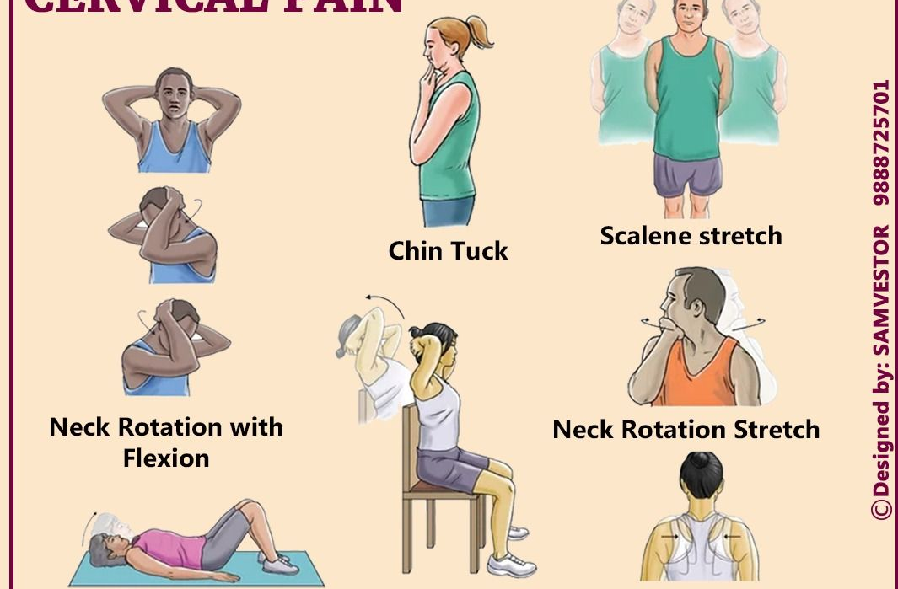

Slide 34
